Slide 1

THREATS AND ATTACKS ON ENDPOINTS
Network and Security (INFO8965)
Pawan Soobhri
Professor
MISSM, PGDBM, BTech
Email: psoobhri@conestogac.on.ca

Slide 2
REFERENCES AND ACKNOWLEDGEMENT
References
[CIAM] “CompTIA® Security+ Guide to Network Security Fundamentals” by Mark
Ciampa, 7th edition, Publisher: Cengage Learning
[STAL] “Network Security Essentials,” by William Stallings, 5th edition, Publisher:
Pearson
Acknowledgement
Some of the material presented is based on:
The referenced textbook [CIAM] by Cengage Learning.
Other references are cited individually.

Slide 3
LECTURE LAYOUT
Attacks using Malware Application Attacks Adversarial AI

Slide 4







THINK, PAIR AND SHARE
Search the Internet for two different phishing simulators.
          Take the phishing challenge on each simulator to determine if you can identify the phishing attacks.
                List the features of the phishing simulators, their ease of use, and how accurate you think they were.
                Would these simulators be helpful in training users about phishing? Share interesting findings with your class on the respective discussion forum.

Slide 5
MALWARE ATTACKS

Slide 6
ATTACKS USING MALWARE
Malware is a collective term for any malicious software that enters a computer system without user’s knowledge or consent and then perform an unwanted and harmful action.
One way to classify malware is to examine their primary action, which includes:
Imprison, launch, snoop, deceive, and evade.
Note: Some malwares have more than one primary action.

Slide 7
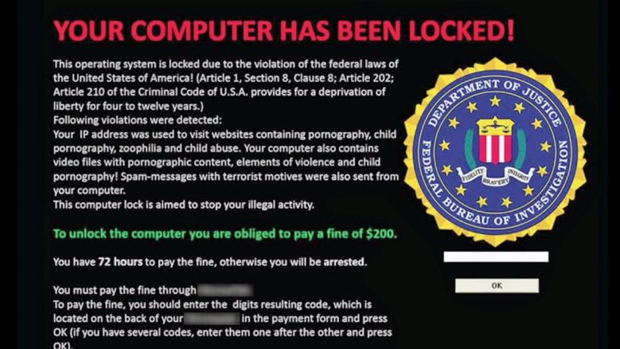
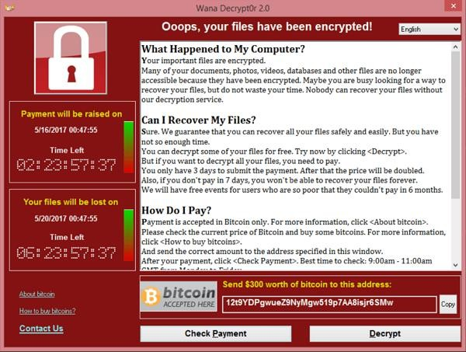
MALWARE CATEGORY - IMPRISON
Some malware types are designed to restrict or deprive users from using their computing devices.
This Photo by Motormille2 is licensed under CC BY-SA
Lockerware
Locks the entire system, preventing any use until a ransom is paid (e.g., Reveton).
Ransomware
Encrypts files and demands payment for decryption (e.g., WannaCry, CryptoLocker).
Suggest Mitigation Strategies
This Photo by Unknown Author is licensed under CC BY-SA

Slide 8
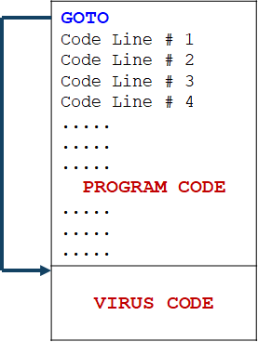
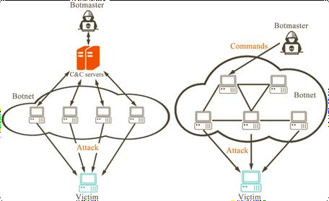
MALWARE CATEGORY - LAUNCH
Another category of malwares infects a computer to launch attacks on other devices. This type includes viruses, worms and bots.
Appender infection
A file-based virus is malicious source code that is attached to a host program – When executed, it replicates
Anti-virus detection is possible due to known virus signature
This Photo by Unknown Author is licensed under CC BY

Slide 9

MALWARE CATEGORY - LAUNCH
Armored file-based viruses use different mechanisms to avoid detection.
            Obfuscation – Uses complex and confusing code structures to hide its true purpose.
            Split infection – split malicious code into multiple parts and then place them at random positions through-out the program code
            Polymorphism – Changes its code with each infection, making it difficult for signature-based detection. (Encryption -> Decryption Routine -> Garbage Code)
            Code injection - Injects its code into legitimate processes to hide its presence.
This Photo by Unknown Author is
licensed under CC BY-NC

Slide 10
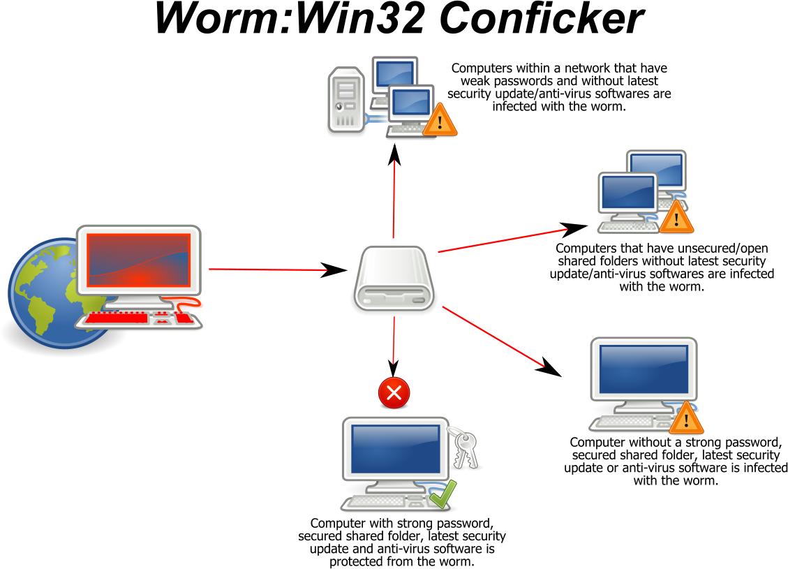
MALWARE CATEGORY - LAUNCH
A worm is a malicious program that uses a computer network to replicate.
Uses application or OS vulnerability to infect the network.
Searches other network nodes having the same vulnerability.
Leaves a payload on systems that might delete files, create a bot, encrypt files or exfiltrate data.
Both viruses and worms self-replicate, what
the difference then?
Viruses: host file or program required – Executed to spread.
Worm: Standalone malware that propagate independently
This Photo by Gppande is licensed under CC BY-SA

Slide 11
MALWARE CATEGORY - LAUNCH
Bot (a.k.a. zombie) is a self-propagating malware that infects its host system and allows the threat actor to control the machine remotely.
Million of infected bot machines create a logical network (a.k.a. botnet) under the control of a bot herder.
This Photo by Unknown Author is licensed under CC BY
Suggest mitigation strategies for this category

Slide 12
Few mitigation strategies for this category
Strengthen Endpoint Security
Network Security Measures
Patch and Update Systems
Enhance Access Control
DNS Filtering and Blacklisting

Slide 13

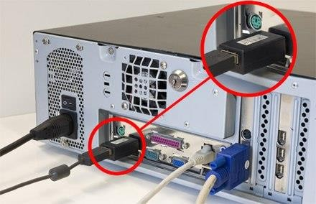
MALWARE CATEGORY - SNOOP
Keylogger secretly captures and stores each
keystroke that a user types on the user’s computer.
Could be a software that is installed remotely or a small hardware device.
This Photo by Unknown Author is licensed under CC BY-SA
Spyware is a malicious software that is designed to infect the system, collect data and distribute it to the threat actor without consent.
Spywares usually download and install malicious/tracking software, track user activities, modify user configurations etc.
This Photo by Unknown Author is licensed under CC BY-SA

Slide 14
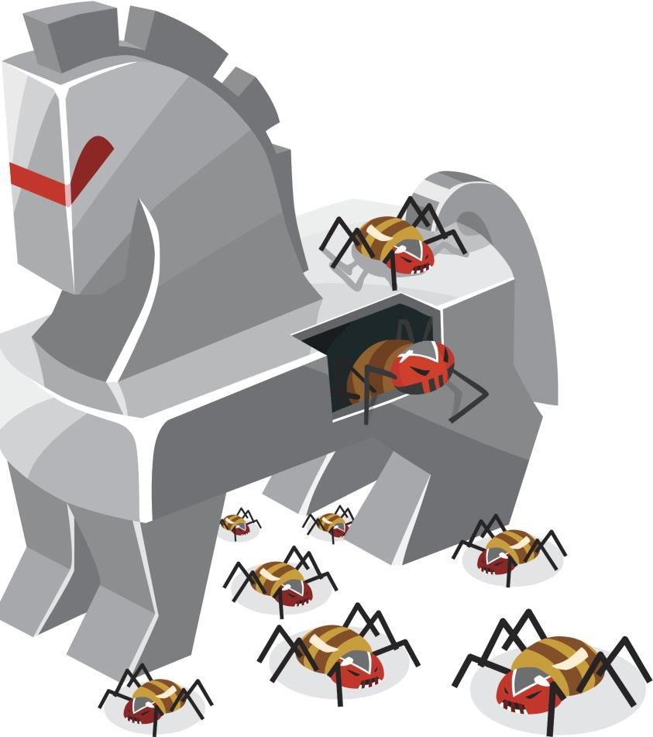
MALWARE CATEGORY - DECEIVE
A PUP (Potentially Unwanted Program) is an annoying unwanted program that user does not want on their devices.
A Trojan horse (or Trojan) is an executable malware that often disguised as legitimate software.
Users are typically tricked by social engineering into loading and executing Trojans on their systems.
Once activated, gain backdoor access to the system and steals sensitive data.
A RAT (Remote Access Trojan a.k.a. creepware) is a tool that gives the threat actor unauthorized remote access to the victim’s system.
This Photo by Starkus01 is licensed under CC BY-SA

Slide 15
MALWARE CATEGORY - EVADE
A backdoor gives access to a computer, program or service that circumvents any normal security protections – Allow the attacker to return later and bypass security settings.
A rootkit is a clandestine malware that is designed to provide privileged access to a computer, while actively concealing its existence and actions from the users and other system processes.

Slide 16
THINK, PAIR AND SHARE
Fileless viruses take advantage of native services and processes that are part of the OS to avoid detection and carry out their attacks. These native services used in a fileless virus are called living-off-the-land binaries (LOLBins).
Use the Internet to research fileless viruses and LOLBins. Answer the following questions:
How do they compare with file-based viruses?
What are the defenses against fileless viruses?
Share interesting finding with your class on the respective discussion forum.
Fileless Viruses: https://www.mcafee.com/enterprise/en-ca/security- awareness/ransomware/what-is-fileless-malware.html

Slide 17
SELF STUDY
Aspect | Fileless Viruses | File-Based Viruses
Infection Method | Do not use traditional executable files; instead, they reside in memory and utilize legitimate system tools. | Infect host machines by attaching to executable files or creating malicious files on the hard drive.
Persistence | Persist by altering system configurations, like Windows registry or scheduled tasks. | Persist by saving infected files to the disk for reuse after reboot.
Execution | Use legitimate OS tools such as PowerShell, WMI, or scripts to execute malicious activities. | Execute malicious code when the infected file is opened or the system is tricked into running it.
Detection Difficulty | Harder to detect since they don’t leave files on the disk and rely on trusted processes. | Easier to detect using signature-based methods, as they create identifiable malicious files.
Impact | Often used in advanced persistent threats (APTs) for stealthy attacks, data theft, and espionage. | Typically used for widespread attacks like ransomware or basic malware infections.
Defense:
Endpoint Detection and Response (EDR) Solutions, Behavioral Monitoring, Application Whitelisting, Patch Management, Disable Unnecessary Features, Email Security, Memory Forensics, Network Segmentation, Limit Administrative Privileges, Regular Backups

Slide 18
KNOWLEDGE CHECK ACTIVITY
What is the primary action that cryptomalware performs?
Imprison
Launch
Snoop
Deceive

Slide 19
APPLICATION ATTACKS

Slide 20
APPLICATION ATTACKS
Software or application attacks look for vulnerabilities in the program or manipulate it to compromise it.
Attacks using malware typically add malicious software to an endpoint. Application attacks specifically targets software applications that are already installed and running on the device.
Category continues to grow
Web application attacks
Vulnerabilities written into the code
Zero-day attacks
Threat actor exploit previously unknown vulnerabilities
Difficult to discover and often take months and sometimes years before the vulnerability is patched.

Slide 21
APPLICATION ATTACKS – XSS ATTACK
In cross-site scripting (XSS) attack, a website that accepts user input without validating it (called sanitizing) and uses that input in a response, can be exploited.
An attacker tricks a valid website into feeding a malicious script to another user’s web browser, which will then execute it.
One of the most frequent targets are websites that allow users to share content, including blogs, social networks, video sharing platforms and message boards.
Prevention:
Sanitize Input: Take a zero-trust approach to user input data.
Implement code vulnerability testing
https://owasp.org/www-project-top-ten/

Slide 22
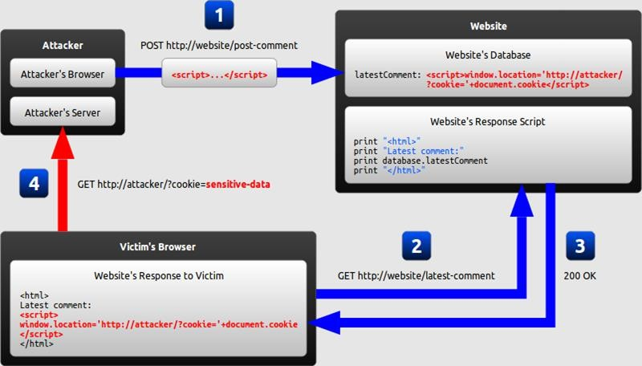
This Photo by Batka savemazaalai is licensed under CC BY-SA 4.0

Slide 23

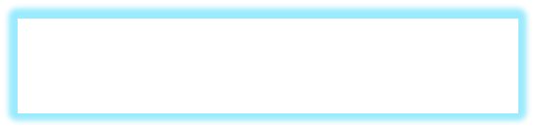

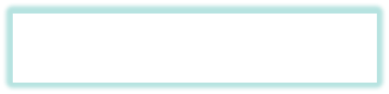
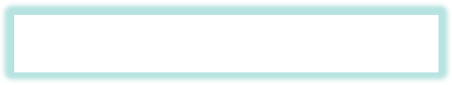
APPLICATION ATTACKS – SQL INJECTION
SQL injection attack consists of injecting an SQL query via the input data from the client to the application.
🢝 It is used to attack data-driven application in which malicious SQL statements are inserted into
an entry field for execution. Can be used to extract or manipulate data.
Username: Password: Forgot Password
SELECT column FROM table
WHERE field = ‘$EMAIL’
Enter your email address.
Email:
Enter your email address.
Email: threat-actor@fakeemail.com’
Enter your email address.
Email: ____________________
A Password Reset URL is sent your registered Email Address.
Message: Server Failure
A Password Reset URL is sent your
registered Email Address.
ALI HASSAN
22

Slide 24
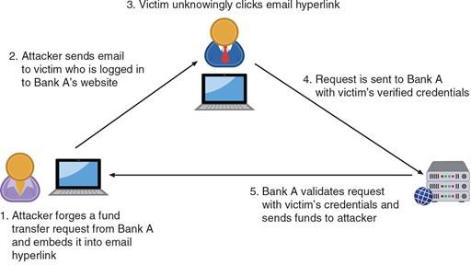
APPLICATION ATTACKS – REQUEST FORGERY
Cross-site request forgery (CSRF) tricks a web browser (and victim) into executing an unwanted action in an application or on a website, to which a user is authenticated in.
Figure: Cross-site request forgery
“CompTIA® Security+ Guide to Network Security Fundamentals” by Mark Ciampa, 7th edition, Publisher: Cengage Learning, © 2022 Cengage

Slide 25
APPLICATION ATTACKS – REQUEST FORGERY
Server-side request forgery (SSRF) attacks exploits how a web server processes external information received from another server.
SSRF manipulates trust relationship between web servers.
Some web applications are designed to read information from or write information to a specific URL.
Attacker supply or manipulates target URL, which the code running on the server will read or submit data, to extract sensitive information or inject untrusted input into it.
https://my.f5.com/manage/s/article/K36263043

Slide 26
ATTACKS ON SOFTWARE – MEMORY VULNERABILITIES
Several attacks are directed at vulnerabilities associated with how a program uses RAM.
They are often result of poor techniques (or laziness) by the software developer.
The resource exhaustion attacks deplete parts of memory and thus interfere with the normal operation of the program in RAM.
The most common result of resource exhaustion is Denial Of Service (DOS) – different from DDOS
Memory leak - memory is allocated, but not deallocated even when not required

Slide 27
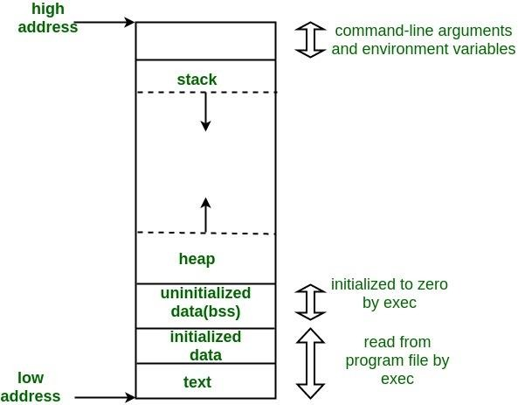
ATTACKS ON SOFTWARE – MEMORY VULNERABILITIES
A buffer overflow condition exists when a program attempts to put data in a memory area past a buffer.
Writing outside the bounds of a block of allocated memory can corrupt data, crash the program, or cause the execution of malicious code, possibly taking over the machine.
By sending carefully crafted input to an application, malicious actor can overflow the buffer with a new address pointing to the attacker’s malware code.
Memory Layout of C Programs

Slide 28
Stack Top
ESP
STACK BUFFER OVERFLOW
0x420
Local Variables (BUFFER)
Saved %ebp 0x46c
Return Address
Argument 1 ... Argument n
...
Old %ebp
...
Earlier Stack Frames
Current Stack Frame of Callee DoSomeThing()
EBP
0x438
In stack buffer overflows, an attacker overwrite return address on the stack and redirect the execution flow in order to execute malicious shellcode.
Control EIP
Locate space for shellcode
Redirect the execution flow
Get reverse shell
0x43c
Stack Frame of Caller Main()
0x46c
Earlier Frames
0x30A
Stack Start
27

Slide 29

Stack Top
ESP
STACK BUFFER OVERFLOW
\xbb\xc8\xc1\x9d \x44\xd9\xf7\xd9 \x74\x24\xf4\x5d \x31\xc9\xb1\x52 \x31\x5d\x12\x83
\xed\xfc\x03\x95 \xcf\x7f\xb1\xd9 \x38\xfd\x3a\x21
\xb9\x62\xb2\xc4
... ... ...
...
Old %ebp
...
Earlier Stack Frames
0x420
Local Variables
Saved %ebp 0x46c Return Address Argument 1
...
Argument n
Current Stack Frame of Callee DoSomeThing()
0x438
0x43c
In stack buffer overflows, an attacker overwrite return address on the stack and redirect the execution flow in order to execute malicious
shellcode.
Control EIP
Locate space for shellcode
Redirect the execution flow
Get reverse shell
JMP ESP
EIP
Stack Frame of Caller Main()
0x46c
Earlier
Frames
0x30A
Stack Start

Slide 30
ATTACKS ON SOFTWARE – IMPROPER EXCEPTION HANDLING
Many times, programs does not properly check for exceptions that may occur when the program is running:
Improper input handling – no user input validation
Error handling – does not properly trap error conditions
NULL pointer/object dereferencing
Malicious actor might use the resulting exception to bypass security logic or cause the application to reveal valuable debugging information.
Can result in a race condition - two concurrent threads of execution (or operations)
access a shared resource simultaneously.

Slide 31
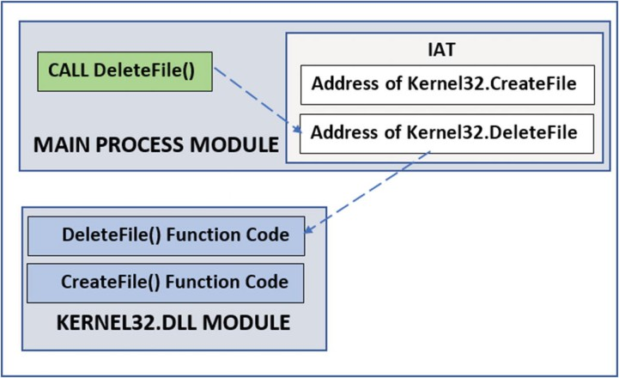
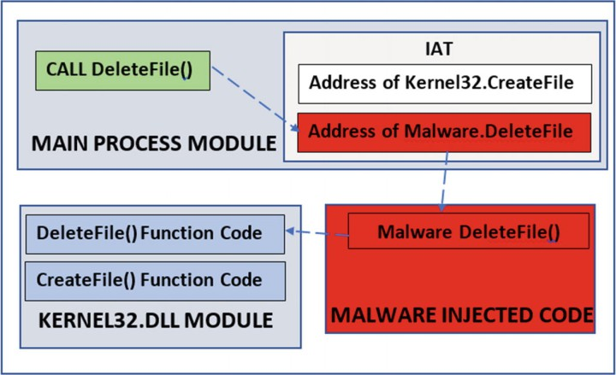
ATTACKS ON EXTERNAL SOFTWARE COMPONENTS
Application program interface (API) are attractive targets for malicious attackers looking for vulnerabilities.
Device driver – Privileged code that controls and operates an external hardware device.
Threat actors may attempt to alter a device driver for use in an attack.
An attacker may use shimming, or transparently adding a small coding library that intercepts calls made by the device and changing the parameters. A shim is typically something written specifically to maintain backwards compatibility.
When the system sends a request to the device driver, the shim intercepts the call, changes the parameters, and then passes it to the driver. This could lead to the attacker gaining control over the device or causing it to perform unintended actions.

Slide 32
KNOWLEDGE CHECK ACTIVITY
Which type of application attack might use the following syntax?
‘whatever’ AND email IS NULL;
Cross-site scripting
Client-side request forgery
SQL injection
Buffer overflow

Slide 33
ADVERSARIAL ARTIFICIAL INTELLIGENCE ATTACKS
Cybersecurity is using artificial intelligence to enhance the detection of malicious behavior and advanced threats
  Significant vulnerabilities and risks with using these new tools
Examples of the use of AI/ML in cybersecurity

Slide 34
RISKS IN USING AI AND ML IN CYBERSECURITY
Risks associated with using AI and ML are called adversarial artificial intelligence
The first risk is the security of ML algorithms
  These could be attacked and compromised, allowing threat actors to alter
algorithms to ignore attacks
Another risk is tainted training data for machine learning
  Attackers can attempt to alter the training data that is used by ML in order to produce false negatives to cloak themselves

Slide 35
KNOWLEDGE CHECK ACTIVITY
Which of the following is a concern of using AI and ML in cybersecurity?
Buffer overflows
Improper input handling
Device driver manipulation
Tainted training data

Slide 36
Questions?

